Slide 1
CS 211: Computer Architecture Digital Logic: Combinational and Sequential Circuits
Abhishek Bhattacharjee
Reading:
Chapter 4: Section 4.2

Slide 2
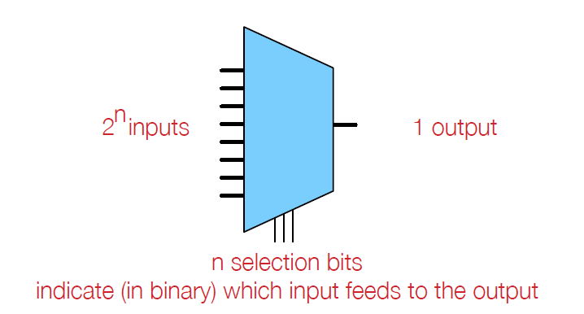
Multiplexers (Muxes)
Combinational circuit that selects binary information from many inputs to one output

Slide 3
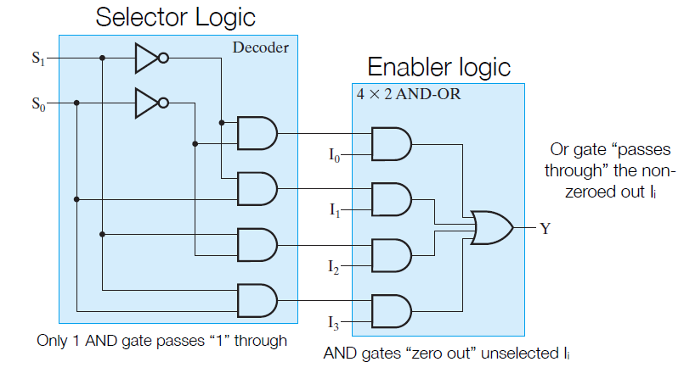
Internal Mux Organization

Slide 4
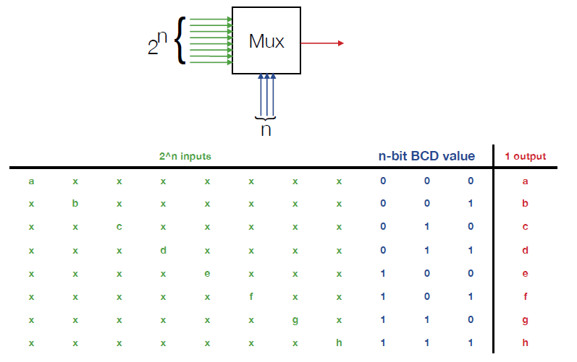
Mux Truth Table

Slide 5
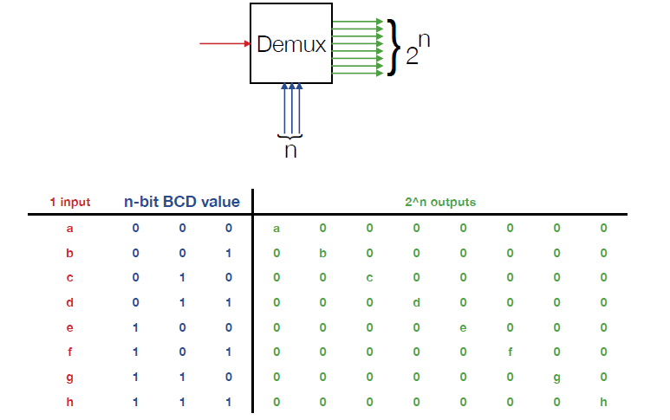
Demultiplexer (Demux)

Slide 6
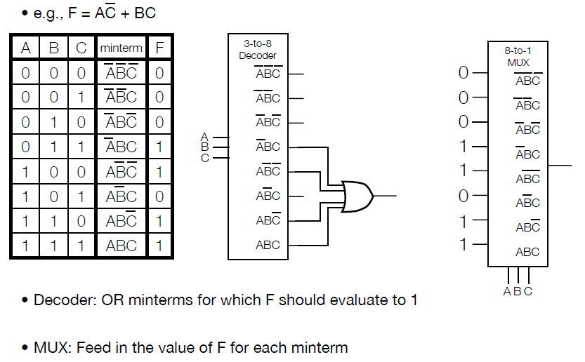
Functions with Decoders or Muxes

Slide 7

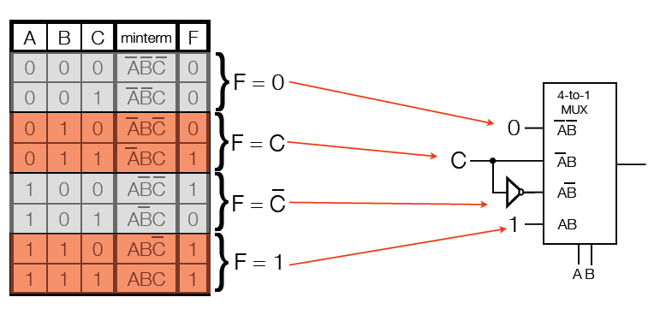
A Mux Trick
Can actually use a smaller mux with a trick:
Look at the rows below, A & B have the same value, C iterates between 0 & 1
For the pair of rows, F either equals 0 or 1, C or not(C)

Slide 8
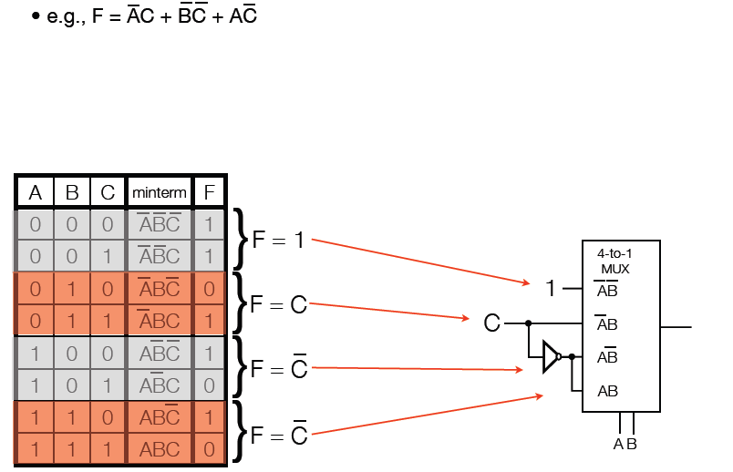
Another Mux Trick

Slide 9
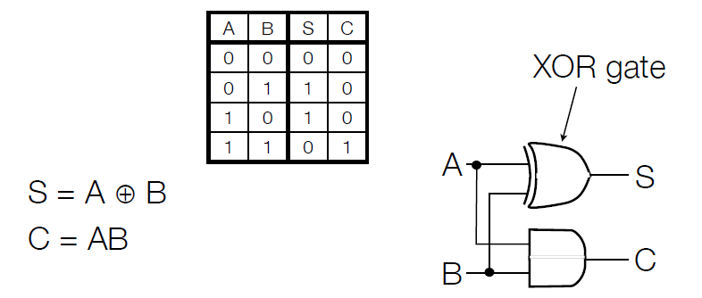
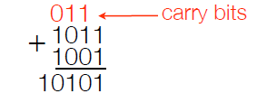
Addition: The Half Adder
Addition of 2 bits: A & B produces summand (S) and carry (C)
But to do addition, we need 3 bits at a time (to account for carries)

Slide 10
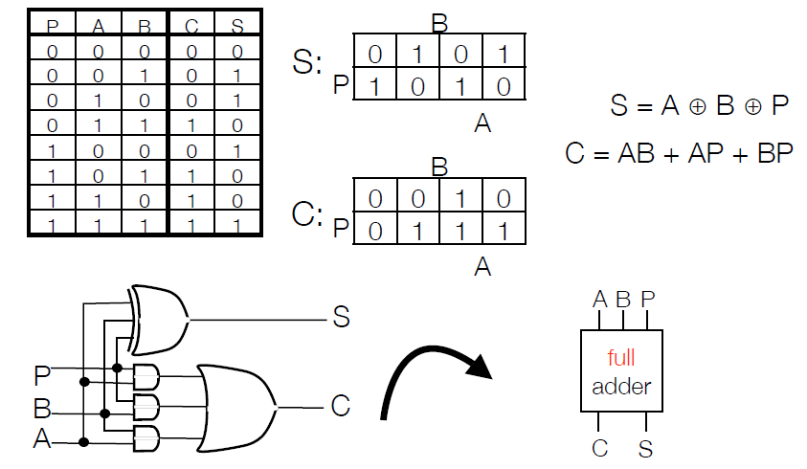
The Full Adder
Takes as input 2 digits (A&B) and previous carry (P)

Slide 11
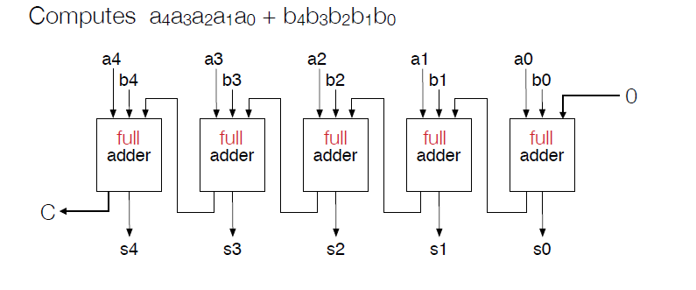
5-bit Ripple Carry Adder
Note how computation ripples from left to right
Each adder has depth 2 (input passes through 2 gates to reach output)
Full adder that computes s_{i} cannot start its computation until previous full adder computes carry
The longest depth in a k-bit ripple carry adder is 2k

Slide 12
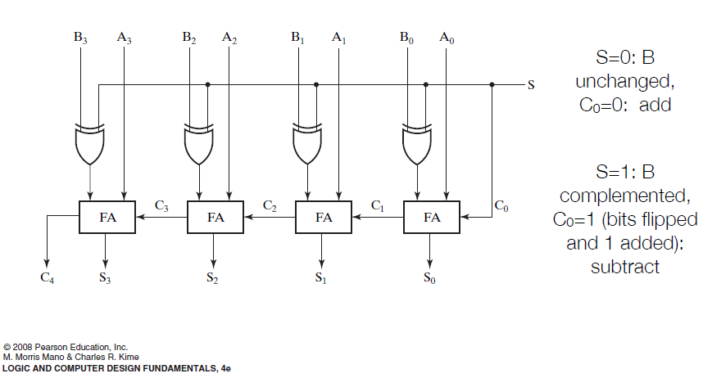
Adder/Subtractor in 2’s Complement Form

Slide 13
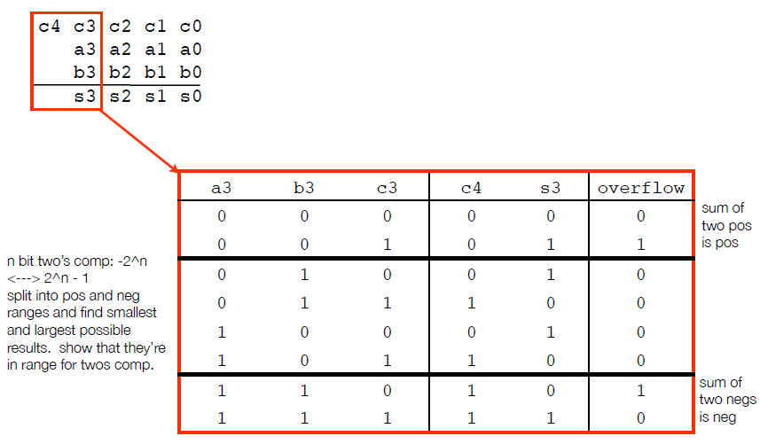
Handling Overflow

Slide 14
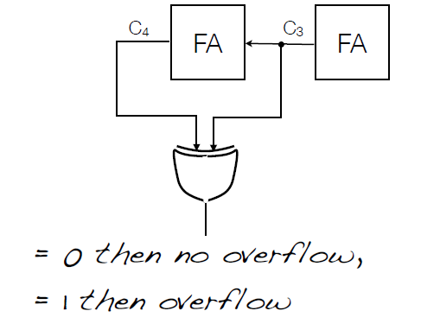
Overflow Computation in Adder/Subtractor
For 2s complement, overflow if 2 most significant carries differ

Slide 15
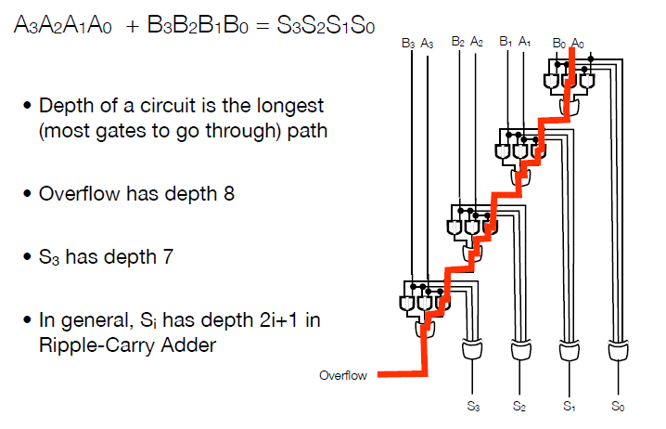
Ripple Carry Adder Circuit Depth

Slide 16
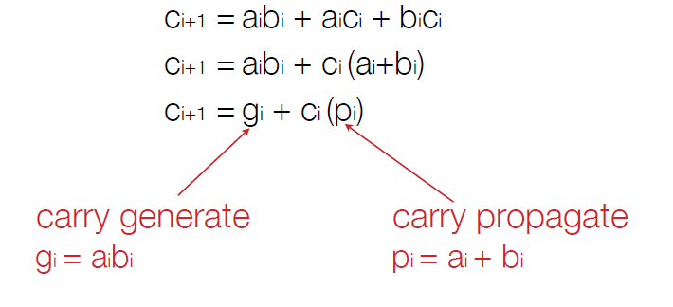
Carry Lookahead Adder (CLA)
Goal: produce an adder circuit of shorter depth
Mechanism: rewrite the carry function

Slide 17
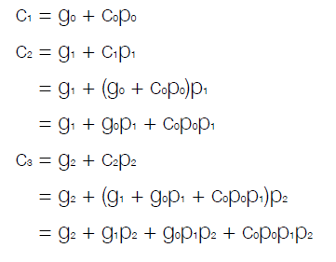
Carry Lookahead
Recursively define carries in terms of propagate and generate signals
ith carry has i+1 product terms, the largest of which has i+1 literals
If AND, OR gates can take unbounded inputs, total circuit depth is 2 (SoP form)
If gates take 2 inputs, total circuit depth is 1 + log₂(k) for k-bit addition

Slide 18
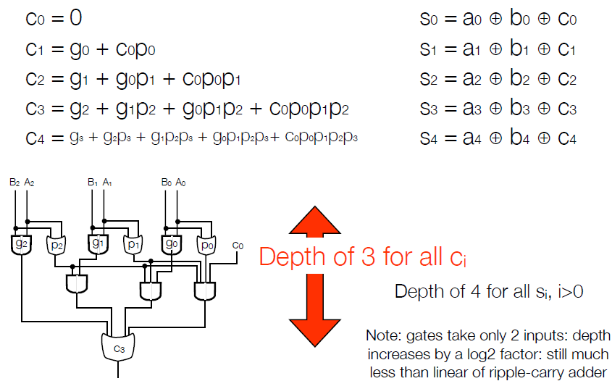
Carry Lookahead

Slide 19
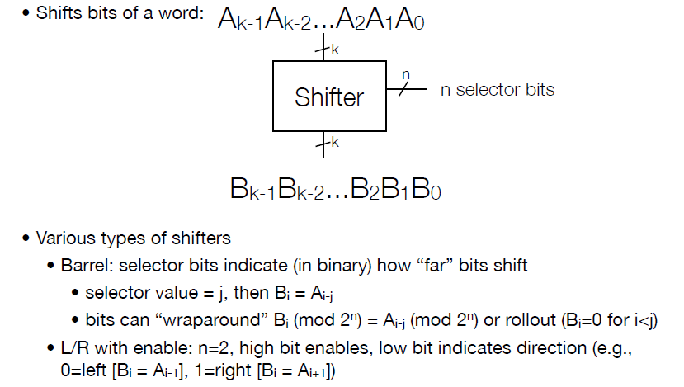
Shifter Circuit

Slide 20
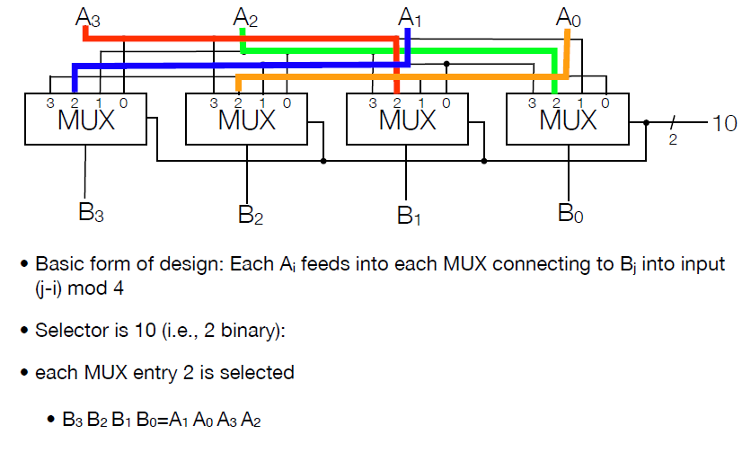
Barrel Shifter with Wraparound Using Muxes

Slide 21
Now on to Sequential Circuits
Latches
Set/Reset
D
Flip-flops
D
T
Enabled
Resettable
Registers
Counters

Slide 22
How are Sequential Circuits different from Combinational Circuits?
Outputs of sequential logic depend on both current and prior values – it has memory
Definitions:
State: all the information about a circuit to explain its future behavior
Latches and flip-flops: state elements that store one bit of state
Synchronous sequential elements: combinational logic followed by a bank of flip-flops

Slide 23
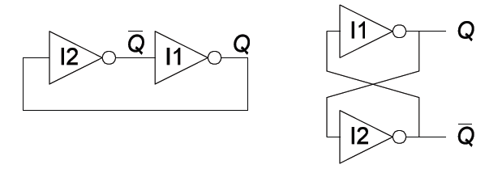
Bistable Circuits
Fundamental building blocks of other elements
No inputs
Two outputs (Q and Q’)

Slide 24
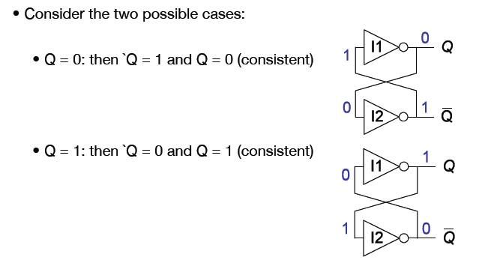
Bistable Circuit Analysis
Consider all the cases
Bistable circuit stores 1 bit of state (Q, or Q’)
But there are no inputs to control state

Slide 25
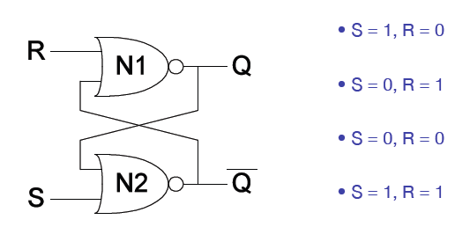
Set/Reset Latch

Slide 26
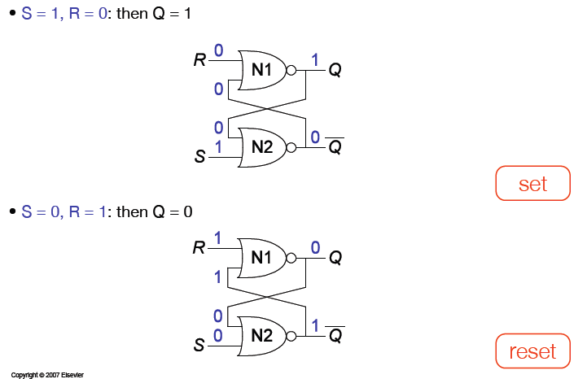
S/R Latch Analysis

Slide 27
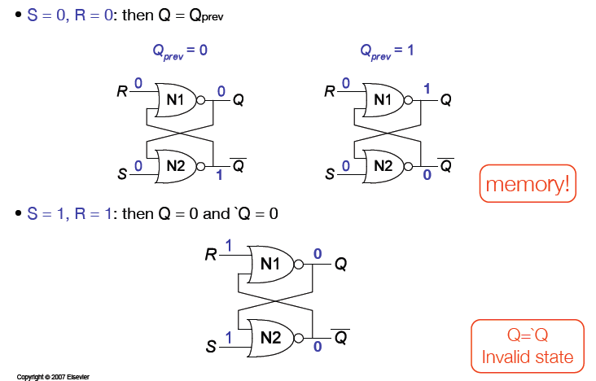
S/R Latch Analysis

Slide 28
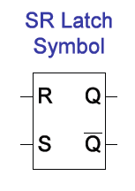
S/R Latch Symbol
Set operation – makes output 1 (S = 1, R = 0, Q = 1)
Reset operation – makes output 0 (S = 0, R = 1, Q = 0)
What about invalid state? (S = 1, R = 1)

Slide 29
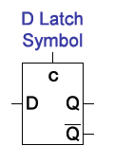
D Latch
Two inputs (C and D)
C: controls when the output changes
D (data input): controls what the output changes to
When C = 1, D passes through to Q (transparent latch)
When C = 0, Q holds previous value (opaque latch)

Slide 30
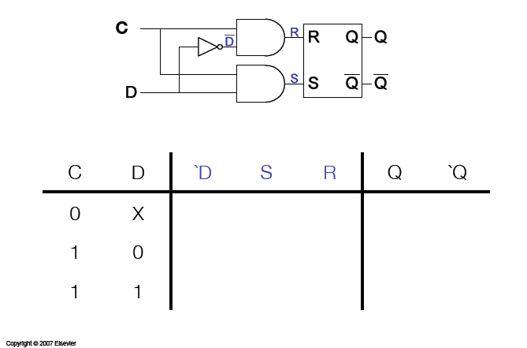
D Latch Internal Circuit

Slide 31
What are we going to do with Flip-Flops?
To do computations, we need more than just combinational circuits
We need to use past circuit state to influence future output
But how do we coordinate computations and the changing of state values across lots of different parts of a circuit?
We use CLOCKING (eg. 1GHz clock on Intel processors)
On each clock pulse, combinational computations are performed, and results stored in latches
How to introduce clocks into latches?

Slide 32
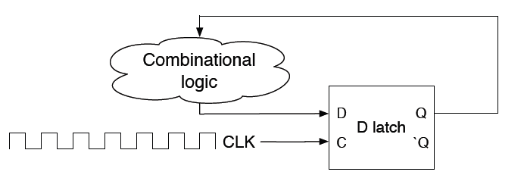
Flip-flops: Latches on a Clock
A straightforward latch is not safely synchronous (or predictably synchronous)
Flip-flops designed so that outputs will NOT change within a single clock pulse

